Slide 1
Assignment-Discussion vector based POS Tagging
200050033-Desai Divyeswar Reddy
200050056-Kajal Malik
200050117-Reddy Bhavana
^{Nth} ,November 27,2022
Notes:
1

Slide 2
Problem Statement
Given a sequence of words, produce the POS tag sequence
Technique to be used: HMM-Viterbi
Use Universal Tag Set (12 in number)
5-fold cross validation
Tags : 'NOUN', 'VERB', 'X', 'CONJ', '.', 'PRON', 'DET', 'ADJ', 'ADV', 'NUM', 'ADP', 'PRT'

Slide 3
Comparision of overall performance
 | Precission | Recall | F1 | F2 | F0.5
Symbolic | 0.93 | 0.91 | 0.921 | 0.916 | 0.92
part1 | 0.94 | 0.94 | 0.946 | 0.947 | 0.945
part2 | 0.9574 | 0.9717 | 0.9633 | 0.95 | 0.96

Slide 4
Per POS performance
Tag: P , R , F1 , F0.5 , F2 :
DET : 0.96953034 , 0.9786094 , 0.9740487201203046 , 0.9713326622030745 , 0.9767800100097664
NOUN : 0.96558666 , 0.84600323 , 0.9018481129230704 , 0.9390398427542281 , 0.8674901877068782
ADJ : 0.9252692 , 0.88120663 , 0.902700524141854 , 0.9161076373512281 , 0.8896801733469559
VERB : 0.96933126 , 0.8997843 , 0.9332639551387506 , 0.954574920520505 , 0.912883748674741
ADP : 0.9387516 , 0.944234 , 0.9414848209897068 , 0.9398429725627309 , 0.9431324158737862
. : 0.9985495 , 0.9981349 , 0.9983421498664758 , 0.998466548329696 , 0.9982177823968827
ADV : 0.5319553 , 0.8834498 , 0.6640583727569432 , 0.5779441491862118 , 0.7803279777510799
CONJ : 0.74594915 , 0.96493006 , 0.8414255399722476 , 0.7814159798245924 , 0.9114187853516691
PRT : 0.794084 , 0.82575214 , 0.8096085488476907 , 0.8002218488000352 , 0.8192180769725345
PRON : 0.9588516 , 0.9182669 , 0.9381205025068887 , 0.950450161900468 , 0.9261066380591514
NUM : 0.9582765 , 0.897136 , 0.9266988590834118 , 0.9453906682312969 , 0.9087318504322035
X : 0.730659 , 0.18398267 , 0.2939480973162775 , 0.45830333978560384 , 0.21635836807356074

Slide 5
Per POS performance
Tag: P , R , F1 , F0.5 , F2 :
Det:0.9689282 , 0.9792947 , 0.9740839106158685 , 0.9709839457200229 , 0.9772037328139238
Noun : 0.91420424 , 0.96929103 , 0.9409420760069832 , 0.9247149329392937 , 0.957748908037089
ADJ : 0.92866015 , 0.8795973 , 0.9034631235256296 , 0.9184145453126179 , 0.8889907100190634
VERB : 0.95792514 , 0.9441839 , 0.9510049074184853 , 0.9551450142680582 , 0.9469005365234238
ADP : 0.93688595 , 0.9474252 , 0.942126076221563 , 0.9389749798250837 , 0.9452983932957268
. : 0.9985495 , 0.9981349 , 0.9983421498664758 , 0.998466548329696 , 0.9982177823968827
ADV : 0.9356308 , 0.8653127 , 0.8990989785210687 , 0.9206675379454716 , 0.878517863235014
CONJ : 0.9722548 , 0.96015435 , 0.9661667208402993 , 0.9698104057561707 , 0.9625503128959737
PRT : 0.8009432 , 0.81795764 , 0.8093609987007306 , 0.8042892117136877 , 0.8144971562143564
PRON : 0.9605251 , 0.9168602 , 0.9381848900758125 , 0.9514625558564216 , 0.9252727038401164
NUM : 0.9582765 , 0.897136 , 0.9266988590834118 , 0.9453906682312969 , 0.9087318504322035
X : 0.74316937 , 0.19624822 , 0.31050231280124263 , 0.47719300548226506 , 0.2301184705832448

Slide 6
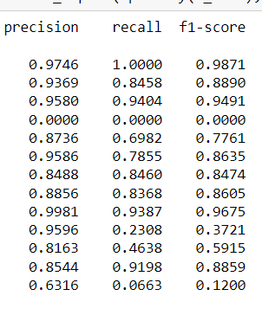
Per POS performance – part2

Slide 7
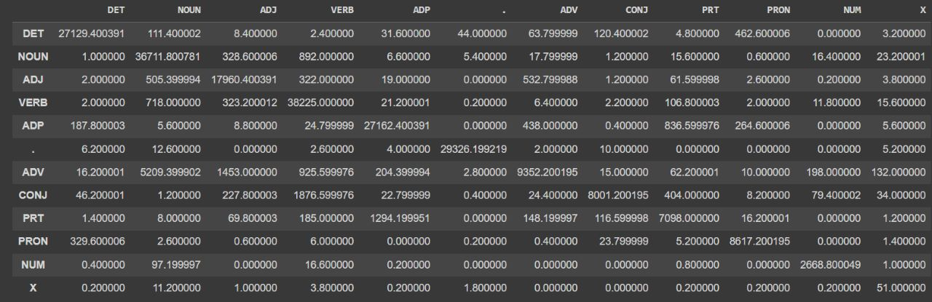
Confusion Matrix (12 X 12) (can give heat map)

Slide 8
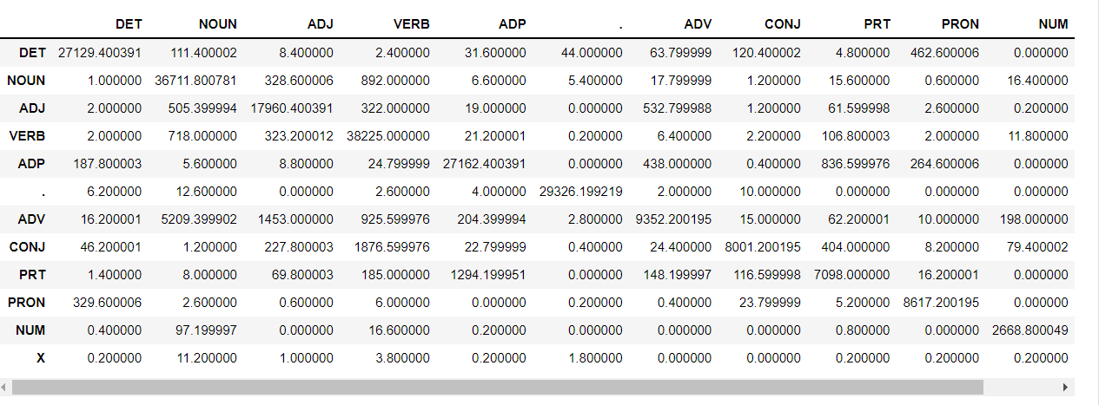
Confusion Matrix (12 X 12) (can give heat map)

Slide 9
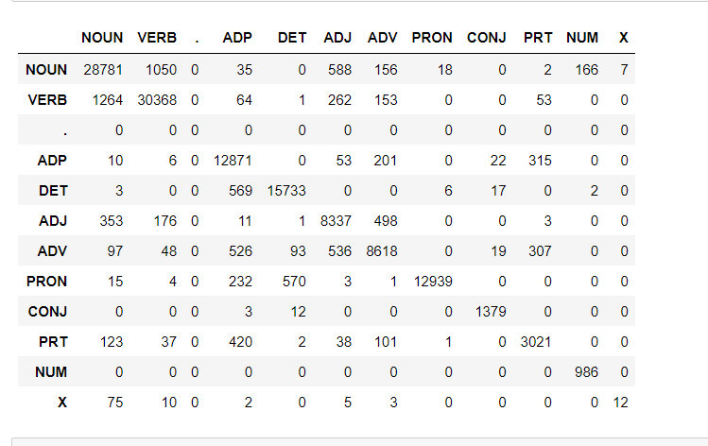
Confusion Matrix (12 X 12) (can give heat map)

Slide 10
Interpretation of confusion (error analysis)
Maximal Confusions :
Viterbi-Noun Verb confusions
part1-Verb Noun Confusions
part2- noun and adj confusions
Reasons :
1)As there are many words in english language which are used as both, noun and verb , like people, dance , bank etc . Which is cause of high values of noun verb and verb noun confusion in confusion matrix.

Slide 11
Data Processing and Data Sparsity
Pre-processing step involves unzipping brown corpus and Tokenizing the words using tokenizer function and the sentences in data is now padded such that all sentence lengths are equal
These words now converted into vectors using word2vec in genism library
For a input sentence if there is no id in tokenizer we use genism library cosine similarity to find nearer words and use that id as the id for the word
If the similar word also is not there then we give id as 0 for that word

